Slide 1



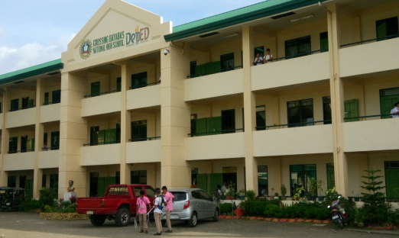
HiSRMS v2.0 Manual
General User Guide for Dummies

Slide 2
Table of Contents

Slide 3
General Terms
Module/System/Application – refers to the program/software installed.
Access Level – refers to a user’s access to a certain program. Access to certain features are restricted to lower levels, while higher levels have less-to-no feature restrictions.
Administrator (Access Level 5) – has full control of the entire system without any restrictions. It is recommended that the School’s IT Personnel should only have administrator accounts for troubleshooting bugs.
Registrar (Access Level 4) – has full control of the entire system with minimal restrictions on each module. The School’s Registry personnel are the recommended users since handling school records are handled and submitted to them.
Curriculum Head (Access Level 3) – has access to Registration System only. He/She is responsible for managing subjects, curriculums and managing Department Head users.
Department Head (Access Level 2) – has access to Grading System only. He/She is responsible for approving grades submitted by advisers during grading period before the Registrar closes the submission.
Teacher/Subject Teacher/Adviser (Access Level 1) – has access to most modules, but limited to basic or advisory work features only. Majority of the School’s staff are the users of this system.

Slide 4


HiSRMS Launcher
01
Opens and manages the modules used by the entire system. It also manages the variables used for processing the records inside other modules.

Slide 5
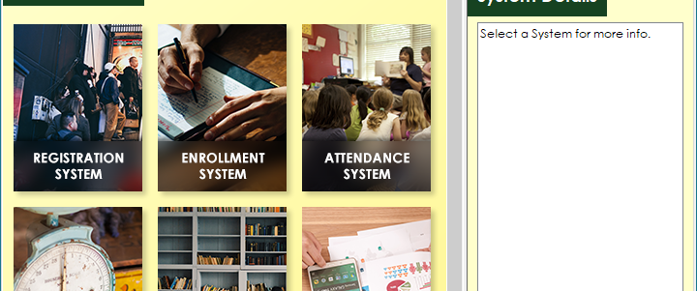
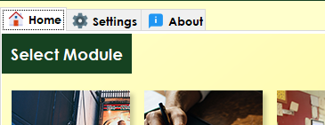
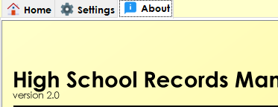

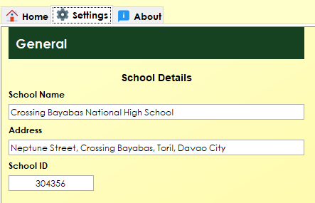
The General User Interface
1. Home Tab
3. About Tab
Contains all the applications/modules installed on the system (7 in total).
Shows detailed information about the software.
2. Settings Tab
Note
Running a module will minimize this window.
Only one instance can only be opened per module. (ex. You can’t open two Registration windows at the same time)
On the Settings Tab, under Performance category, the IP Address field shall be provided by the IT personnel of the school.
Contains modifiable variables that will be used by the other applications when processing data.

Slide 6


Registration System
02
Stores the list of students, teachers, and subjects of the entire school. At the beginning of a school year, this application should be the first one used to register new incoming students and staff during pre-registration or enrollment.
Registrar and Curriculum Head users are allowed to access this Module.

Slide 7
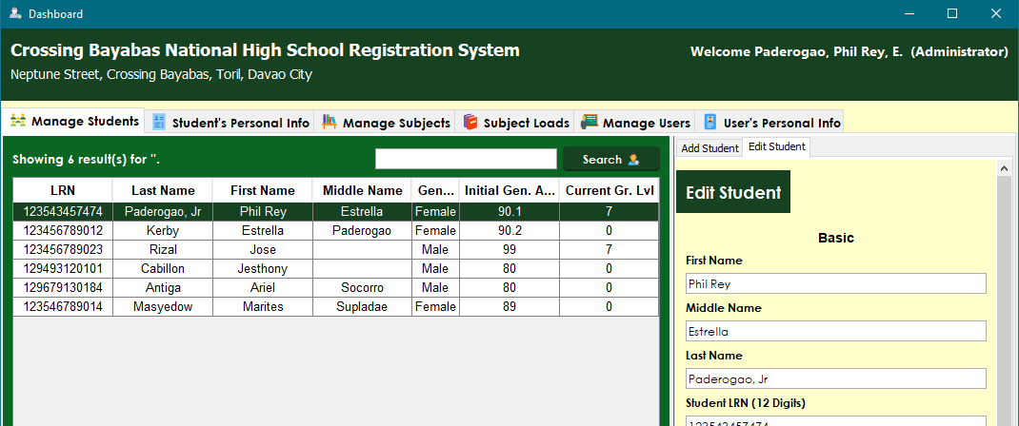
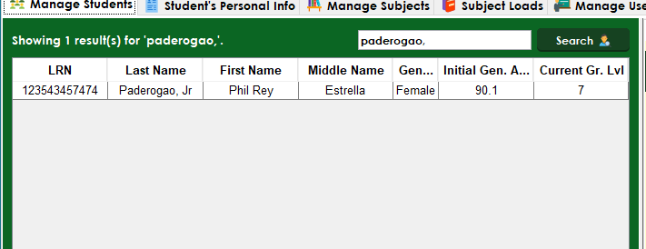
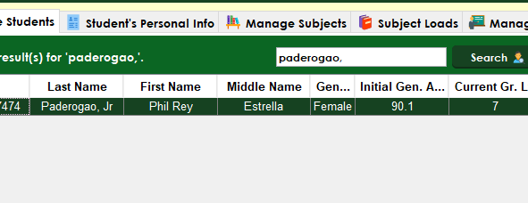
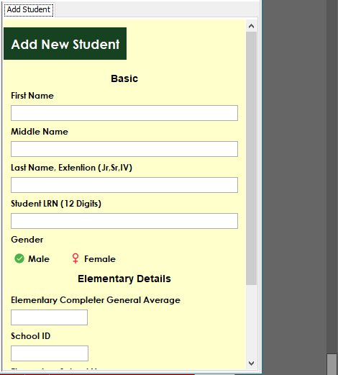
The User Interface
1.0 Manage Students Tab
1.2 Editing a Student
Shows a list of all the students registered in this school.
Search for a student using the search bar.
Double-click on the student selected.
1.1 Adding Students
Note
Middle Name and Extension Name fields are optional.
A first time student registered in this school will have a current grade of 0.
Click on the Add Student tab under Manage Students.
Fill-up all the required fields.
Save changes and add new student.

Slide 8
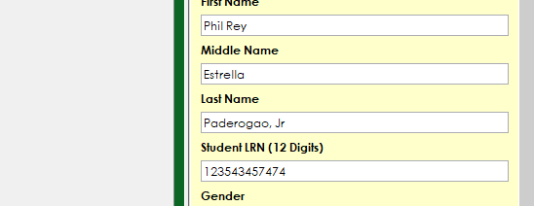

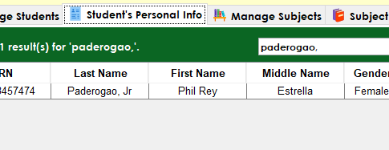
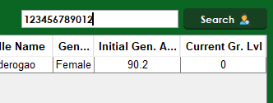
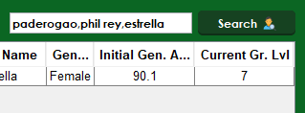

Warning
In case of saving a record with inappropriate special characters, please remember the details of your input and contact your School’s IT Personnel to help resolve the issue.
After selecting a student, an Edit Tab will pop-up on right side near the Add Student tab showing the current student’s details.
Modify and save your changes.
2.0 Student’s Personal Info
Note
When using the search bar looking for students, you can use the Student ID or Full Name method.
When using Student ID method, type the student’s exact student id in the search bar.
When using Full Name method, type in the student’s name in order separated with a comma. It should be written in a last name, first name, middle name order.
These methods are used in all modules globally when doing a student or teacher search.
Manages personal information of students.
Caution
When typing details, please make sure there are no inappropriate special characters included on the information provided.

